Slide 1

MTSS and Eligibility for Special Education:
Tools for Supporting Student Needs
Team Leader Meeting
2015
Notes:
How to engage the MTTSS model to provide RTI and Eligibility for SPED; How do these things relate?

Slide 2
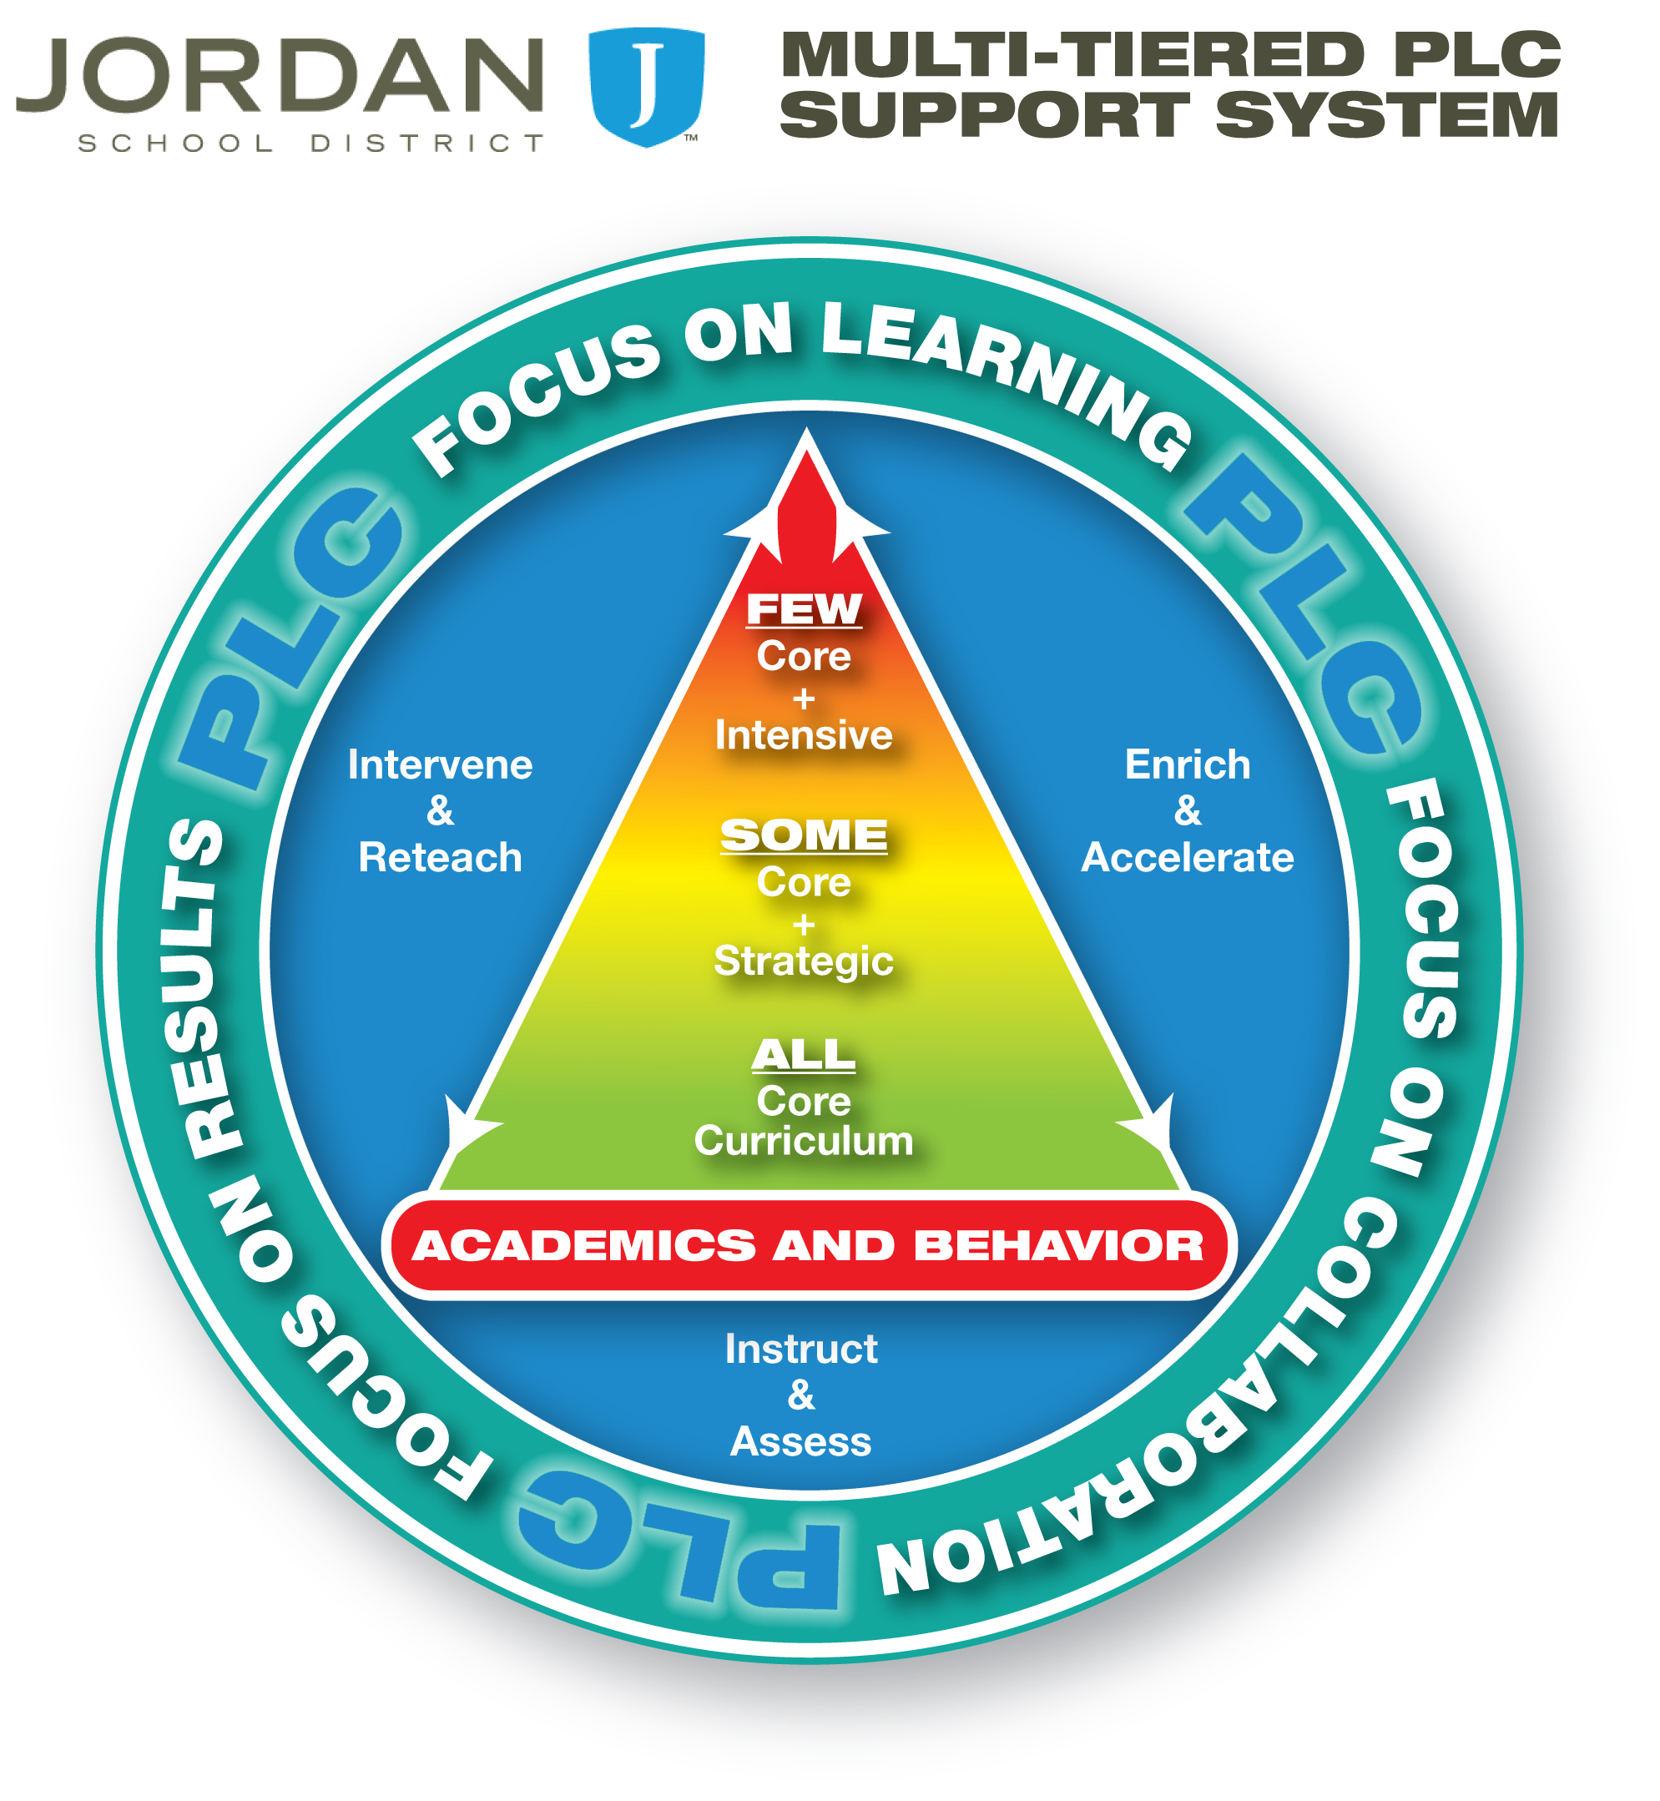

Notes:
Where do SPED students fall within the MTSS system? They really are all along the spectrum here. They need to have access to core but they may also need more supports.

Slide 3
Special Education
What is Special Education?
A set of services and supports tailored to meet the needs of individual students with a disability so that they can progress in the general education curriculum
It requires:
Eligibility &
Impacts the general education setting &
Specially-designed Instruction (SDI)
Notes:
Requires three prongs.

Slide 4

What is Specially-designed Instruction?
The intent is for students with a disability to make progress in the general education curriculum.
Adapting as appropriate to the child’s needs, the content, methodology, or delivery of instruction.
  To address the unique needs of the child
  Ensure access of the student to the general curriculum

Slide 5
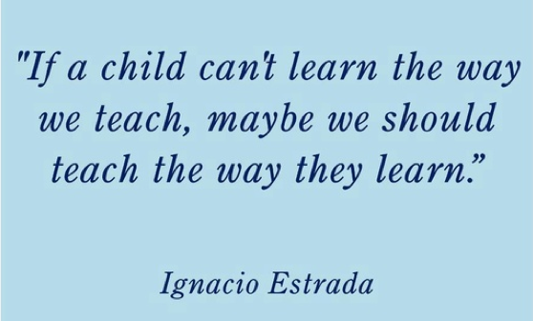

Slide 6
The Four Quadrant Analysis
No Disability Has a Disability
Regular Education | Section 504 ADA
EL Below Avg. Ability/Achievement WBFWR | Special Education/ IEP
Does not
need SDI
Needs
SDI
Notes:
SDI=Specially Designed Instruction
WBFWR= Way behind for whatever reason
There are kids that have disabilities that need specially designed instruction, other students can also require specially designed instruction but don’t have disabilities. This graphic helps us understand what students belong in special education but also helps us understand where specially instruction would be needed.

Slide 7

  “To a man whose only tool is a hammer, the whole world looks like a nail.”
  -Abraham Maslow-
Notes:
If our only tool is SPED to help students who are struggling we’ve totally missed it. Now we are going to talk about other tools that we can use to help any student.

Slide 8
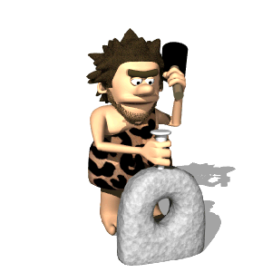
If special education appears to be the only significant intervention tool available in a school, it is inevitable that the school will come to rely upon that tool too frequently.
Notes:
If that is the only tool we have we will overqualify students, we have to have other systems and strategies in place so that SPED is not the only outcome for students who struggle.

Slide 9

Overview of Tools
Tool 1: Background Considerations
Tool 2: Data Based Decision Making
Tool 3: Targeted Intervention
Tool 4: Progress Monitoring and Data Analysis
Notes:
Each table is a group and they have the different tools on their table. The tools on your table represent which “tool” you are going to talk about. Time is given to discuss and then will present to the rest of the group their discussion.
What background info. do you have available to consider when a student starts falling behind?
What data do schools already have available to them that they can use to determine the level of need a student has?
What interventions do schools have available that target specific needs/deficits?
How do you determine if as student is making adequate, minimal or no progress?

Slide 10

Tool 1: Background Considerations
What background information should you consider for a student who appears to be falling behind?
English Language Proficiency
Attendance issues
Previous special education
Vision and hearing
Medical conditions
Discipline records
Adequate instruction in math and reading
Notes:
TOOL 1 SHARE OUT
This tool is really about slowing down, paying attention to what is going on around us and looking at the child’s history. Helps us get a whole picture of the child instead of focusing on just what they look like right now.

Slide 12
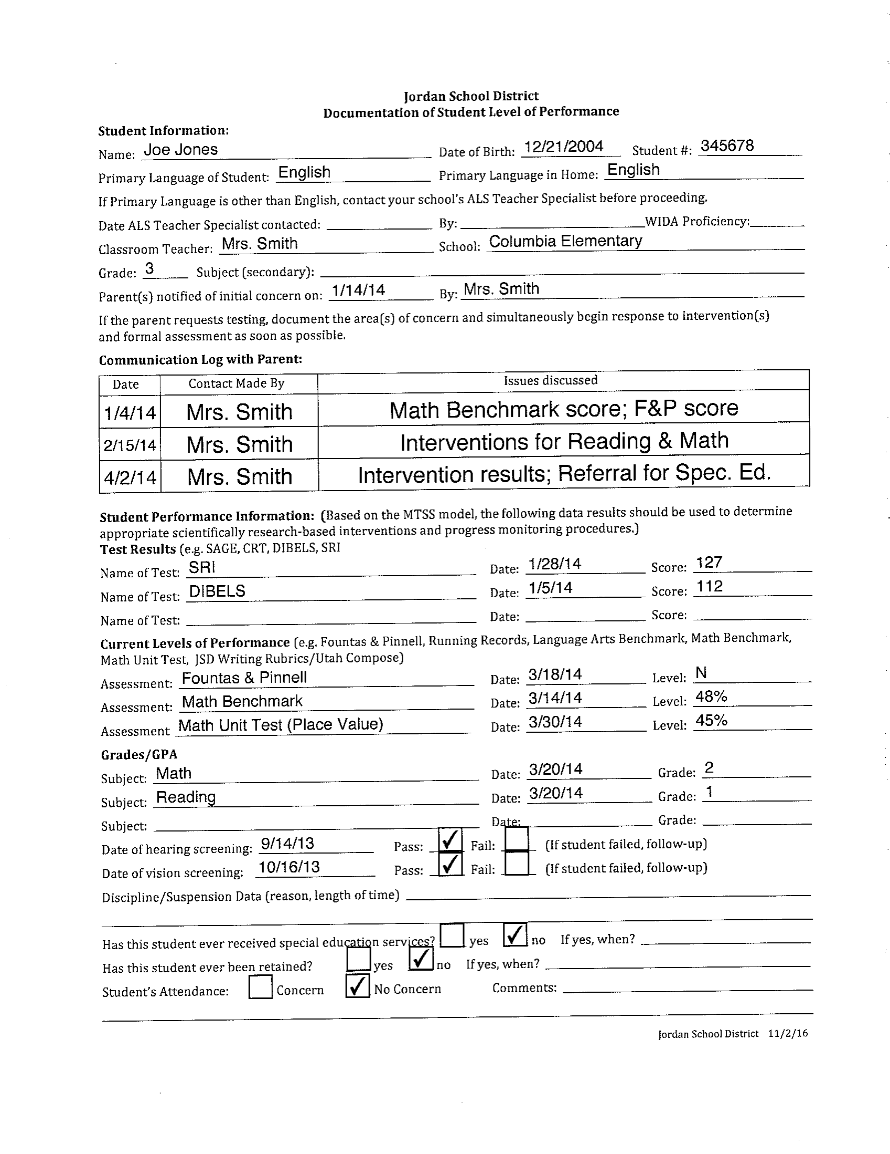
Complete student
information
Is the student an English
Learner? Has the ALS
department been contacted?
Record communications with
parents
Record student performance
Information
Hearing and vision results
Discipline issues?
Retention?
Previous Special Education
Attendance issues?

Slide 13
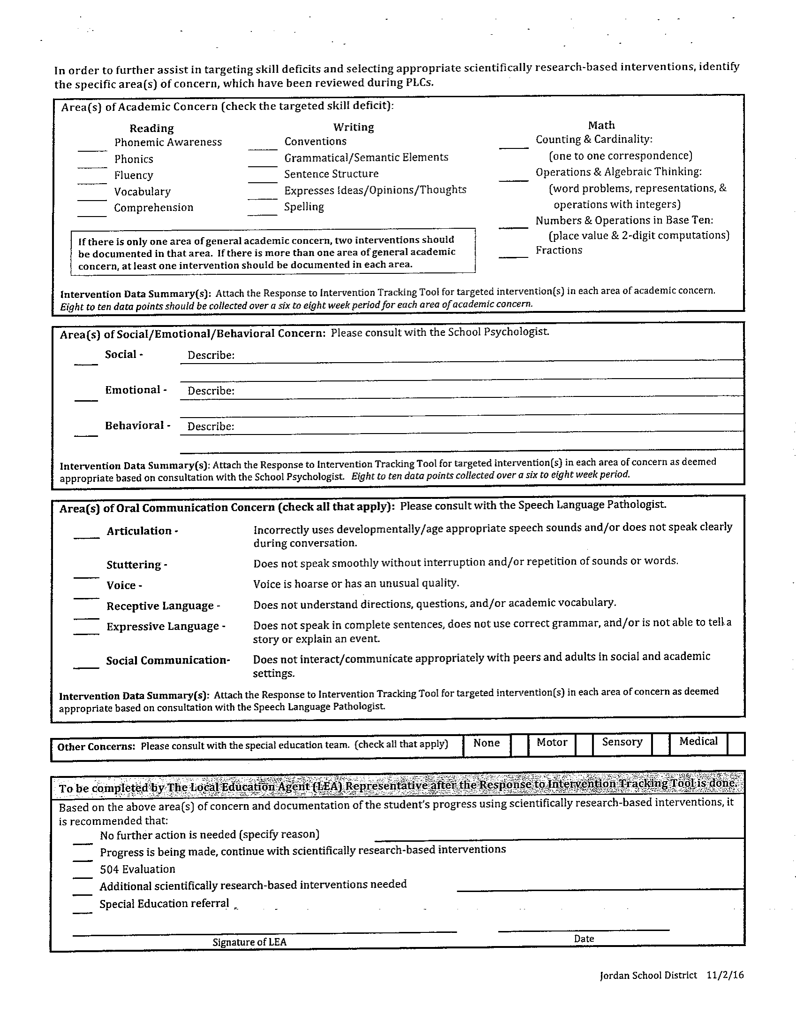

Slide 14
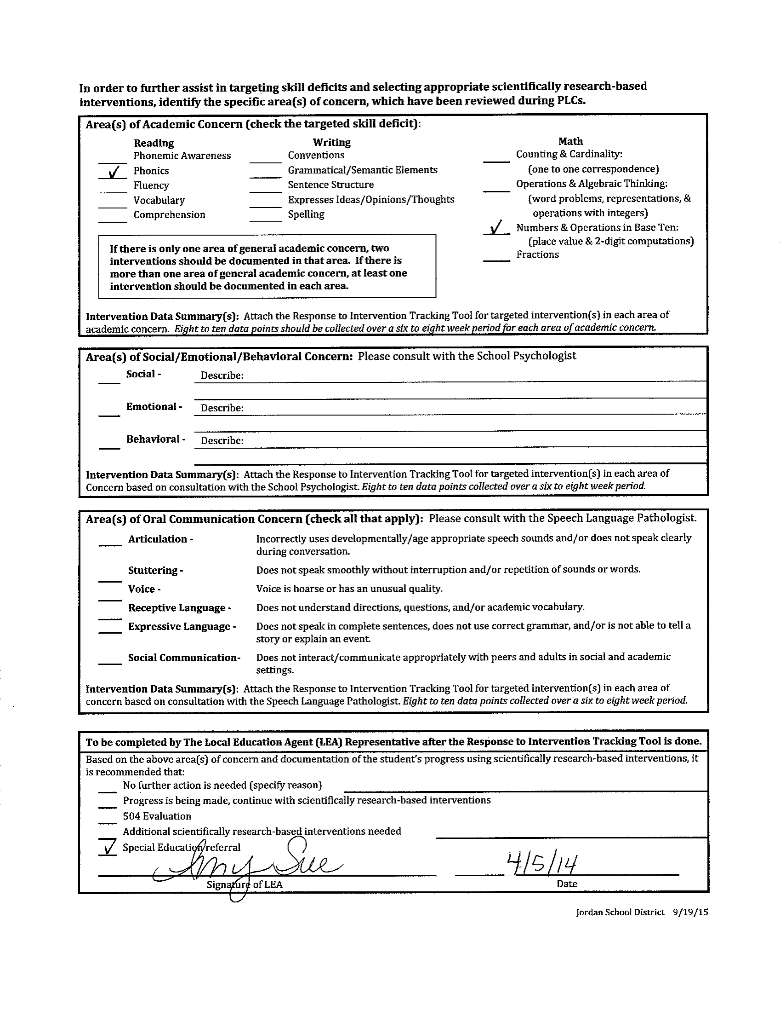
Check Areas of
Concern:
1 area = requires two
interventions
2 or more areas = one
Intervention per area
Social emotional concerns?
Consult with School Psychologist
Communication concerns?
Consult with SLP
After RTI, the team makes a
recommendation for course of
action
Requires LEA signature
Notes:
** Speech/Lang. Pathologist
** School Psychologist
The last box here is something that would be filled out at the very end once a decision is made for a student. You would not fill that out at the beginning, but you would look at it once you have gathered and analyzed data based on RTI.

Slide 15

Tool 2: Data-Based Decision Making
What data is available in your schools?
How do you know if the student has responded to Tier 1 instruction?
Notes:
TOOL 2 SHARE OUT
Ideas: F&P, SRI, benchmarks, SAGE, DIBELS, WIDA
Remember: not just about collecting the data but then about starting to analyze the data to see what the student needs.

Slide 16
Notes:
Student Performance Summary.

Slide 17
More data points =
Stronger trend
detection
It is helpful to graph
expected growth
More data =
A more complete
picture

Slide 18

Tool 3: Targeted Intervention
What targeted interventions do teachers have access to?
Notes:
TOOL 3 SHARE OUT

Slide 19
What is an Intervention?
According to The United States Department of Education, research-based interventions are:
“Strategies, teaching methodologies, and supports that have been shown through one or more valid research studies to help a student improve academic, behavioral/emotional or functional skills.”

Slide 20
An Intervention
Is | Is Not
Evidence based | Location
Specific to individual needs | Curriculum by itself
Skill based | Accommodations
Used over time | Size of the group
Specially-designed Instruction | Who is delivering instruction
Example: Cover-Copy-Compare | Example: iPad academic games
Example: Repeated Reading | Example: Preferential seating

Slide 21

Identifying the Correct Targeted Intervention
Where do the data indicate that the student is functioning in the area of concern?
What is the next logical academic skill that the student needs to be successful in the identified area of deficit?
What evidence based interventions focus on this targeted skill?
How will you measure the student’s progress in the targeted area over time?
Notes:
Steps for deciding what intervention to use with a student.

Slide 22
Intervention Resources
Places to start:
Training in a Bag
  http://specialed.jordandistrict.org/staff/training/
Intervention Central
  http://www.interventioncentral.org/
Curriculum Website
  http://jordandistrict.org/departments/curriculum/
Notes:
(click on each one and show them how to use the resources)

Slide 23

Tool 4: Progress Monitoring and Data Analysis
What tools are available for progress monitoring and decision making in the schools?
How do you determine if a student is making progress?
Up = Good
Flat = Bad
Down = Stop
Notes:
TOOL 4 SHARE OUT
General rule when it comes to data:
Up = good
Flat = bad
Down = stop

Slide 25
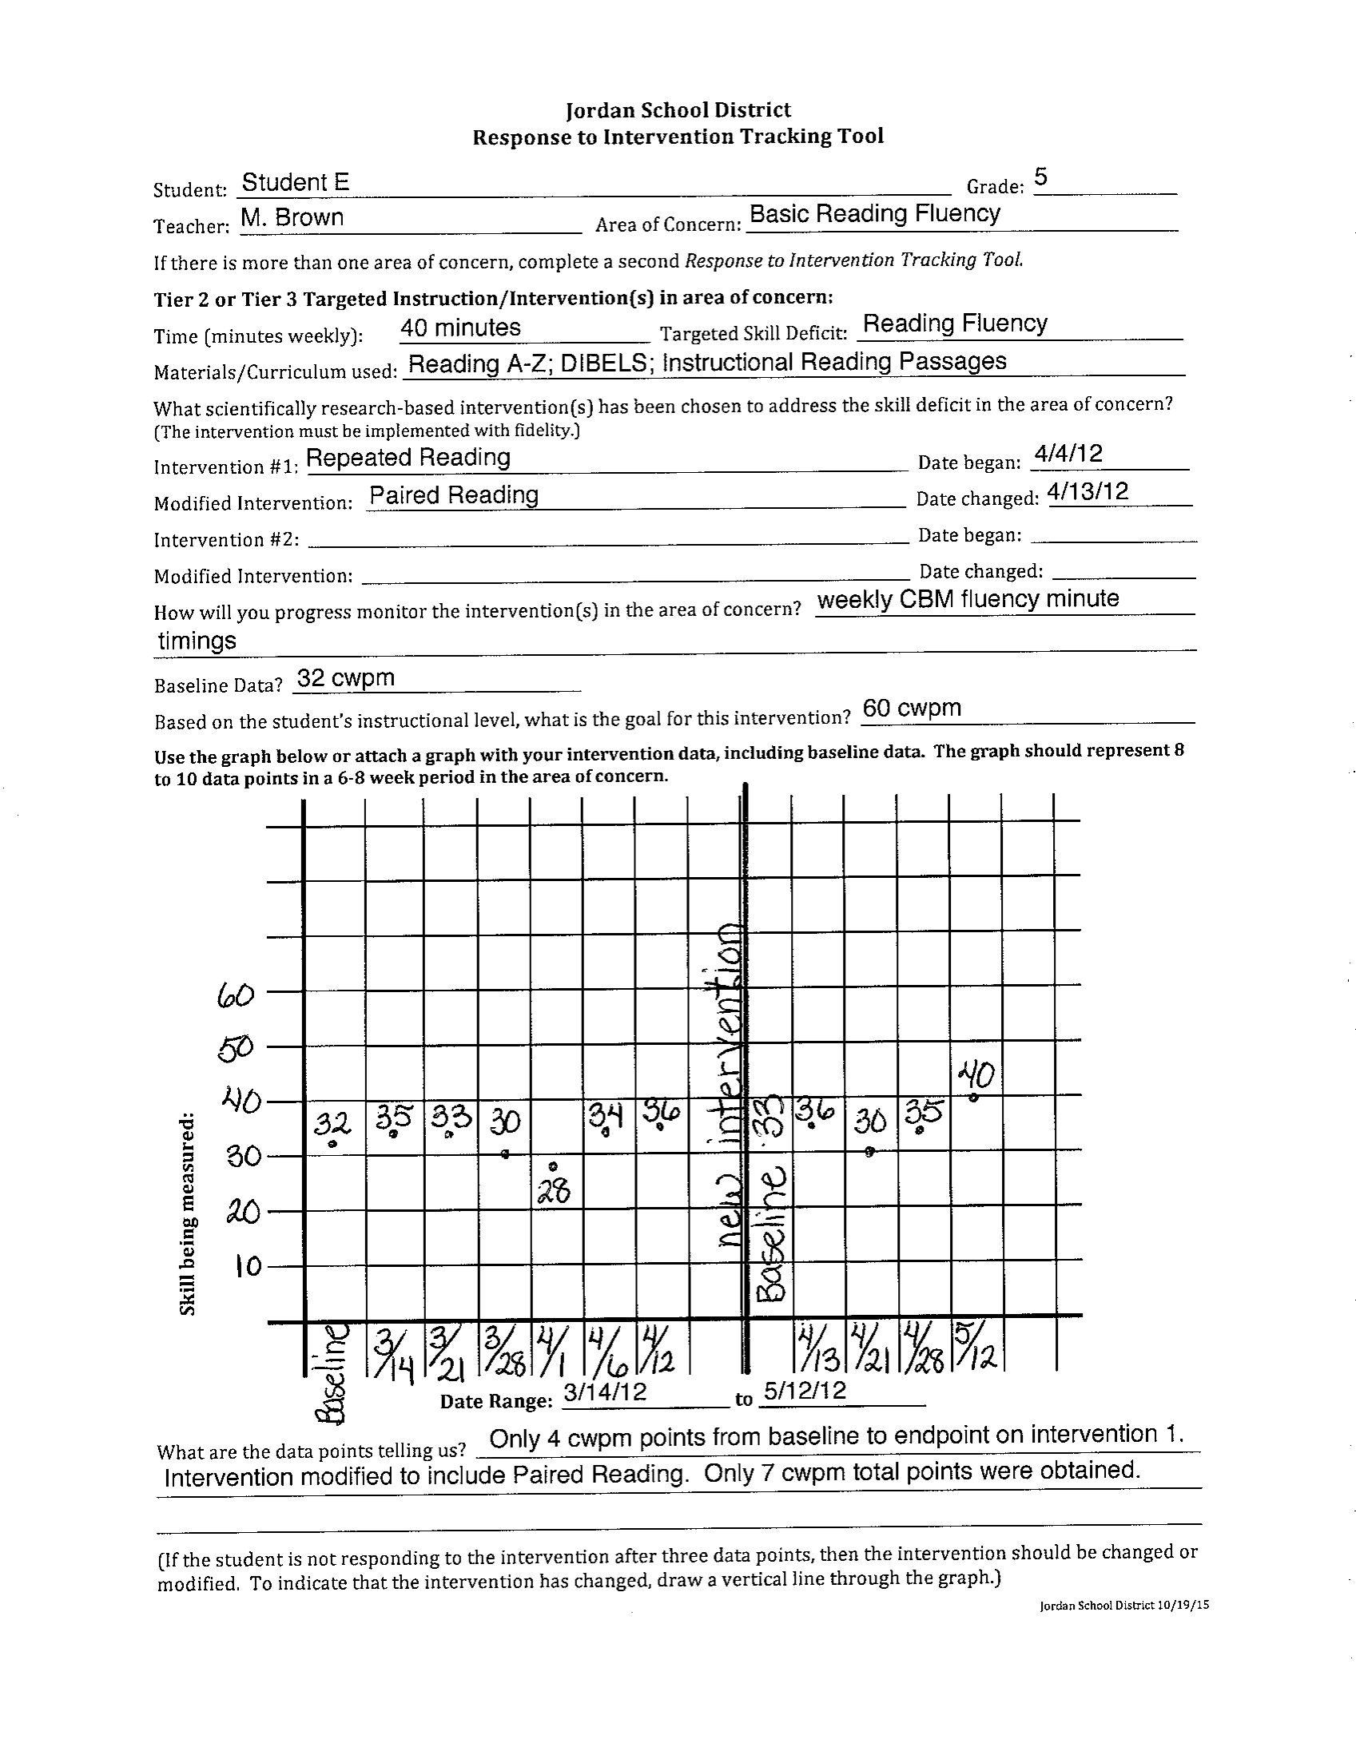
1. Identify intervention
2. Identify the specific
target skill to measure
3. Track data consistently
over time
4. If no progress, make
modifications to the
intervention:
Time
Target Skill
Different Intervention
5. Interpret the data
Notes:
4. If no progress – make modifications. Time might mean doing it more frequently or maybe increasing time from 5 minutes a day to 10 minutes a day.

Slide 26
Decision Making
Possible decisions:
Evaluation for special education services
504 consideration and evaluation
Additional interventions needed
Progress is being made, continue with interventions
No further action is needed
Who is the decision-making team?
PLCs
Notes:
PLC includes SPED Teacher, and if necessary a teacher specialist (EL and or curriculum)

Slide 27
Pulling it all together
Notes:
Using all of the tools together is MTSS.

Slide 28
MTSS
All of the data, the intervention, the analysis and the decision making occur in the general education classroom.
Special educators obtain the data from general education teachers.
Special educators collaborate with general education teachers about the appropriate level of services for students.

Slide 29
Definition of RTI
RTI is part of an MTSS approach for identification and support of students with learning and behavioral needs
The interventions are implemented using gradually increased levels of intensity matched to the students needs
On-going progress monitoring measures the student’s response to intervention and helps determine if the interventions are appropriate or if more intensive support is needed.
Notes:
Implemented using gradually increasing levels of intensity: could mean more time.

Slide 30
Special Education
What is Special Education?
A set of services and supports tailored to meet the needs of individual students with a disability so that they can progress in the general education curriculum
It requires:
Eligibility &
Impacts the general education setting &
Specially-designed Instruction (SDI)
Notes:
One of the decisions that could be made when looking at all our data is a special education referral.
Who knows how many SPED classifications there are for a student to qualify under? Click to next slide.

Slide 31

Special Education Classifications
Autism
Deafblindness
Developmental Delay
Emotional Disturbance
Hearing Impairment/ Deafness
Intellectual Disability
Multiple Disabilities
Orthopedic Impairment
Other Health Impaired
Specific Learning Disabilities
Speech/Language Impairment
Traumatic Brain Injury
Visual Impairment

Slide 32

Determining if a Student has a Disability
The most common is SLD
Specific learning disorder is a neurodevelopmental disorder with a biological origin which includes an interaction of genetic, epigenetic, and environmental factors, which affect the brain’s ability to perceive or process verbal or nonverbal information efficiently and accurately.
Prevalence
  5-15% of children
  More common in males than females
  50.1% of students in special education in Utah
Notes:
We want to be able to use all of the data that we get in Gen Ed to help make eligibility decisions for students who required specially designed instruction and services.
National average is 41.5% of students in special education.

Slide 33
Special Education Rules
The student does not achieve adequately in the areas of:
  Oral Expression
  Listening Comprehension
  Written Expression
  Basic Reading Skills
  Reading Fluency Skills
  Reading Comprehension
  Mathematics Calculation
  Mathematics Problems Solving
And the student does not make sufficient progress when using a process based on the students response to research based intervention
Notes:
Reason the data is so important. It requires not achieving adequately and not responding to interventions.

Slide 34

Psychoeducational Evaluation
No single source data is sufficient for diagnosis or educational classification of SLD. Rather, SLD is a synthesis of the individuals medical, developmental, educational and family history; impact of the disorder on academic functioning, and scores from individual standardized tests of academic achievement.
Notes:
No Single source: We have been developing these forms as a way to help schools use all of the tools. The use of this process will represent a significant change for many schools.
DSM-5 and state handbook
Explain Psychoeducational Evaluation

Slide 35

Assessment of SLD
Background Considerations
RTI Data
Cognitive testing
Achievement Testing
Discrepancy
Observation
Notes:
The first two points are what you as teachers are going to use as you help in this process and are important tools in our tool box.

Slide 36
Meeting the Needs of all Students

Slide 37

What can I do?
Use collaboration meeting time to collaborate about specific student and student needs
  Schedule your time
Ensure that interventions for all students are appropriate and done with fidelity
    Identify appropriate interventions
    Identify data collection procedures
    Be a problem solver

Slide 38

Remember…
The teacher who a student gets within a school matters more than which school the student happens to attend.
  Nye, Konstantopoulos, & Hedges, 2004
The teacher has a larger influence on student achievement than any other school related factor, including class size and ability levels within a class
  Wright, Horn, & Sanders, 1997

Slide 39
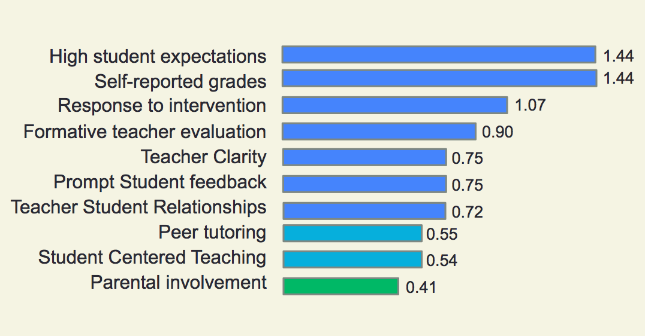
The Impact of RTI on Student Achievement
John Hattie
Notes:
thousands of studies, looking at hundreds of millions of students worldwide. Through his research, Hattie pinpoints things teachers and schools can do to maximize our time with students; ensuring they achieve at least one year’s progress for one year’s input. (John Hattie)

Slide 40
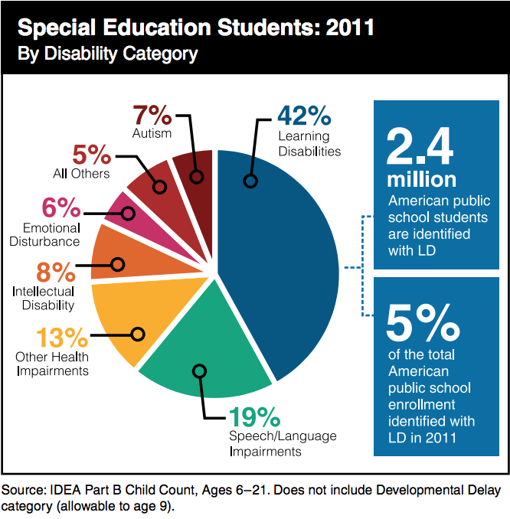
Together we can make a difference!
SLD if by far the largest category for Special Education
Notes:
National Center for Learning Disabilities 2014

Slide 41
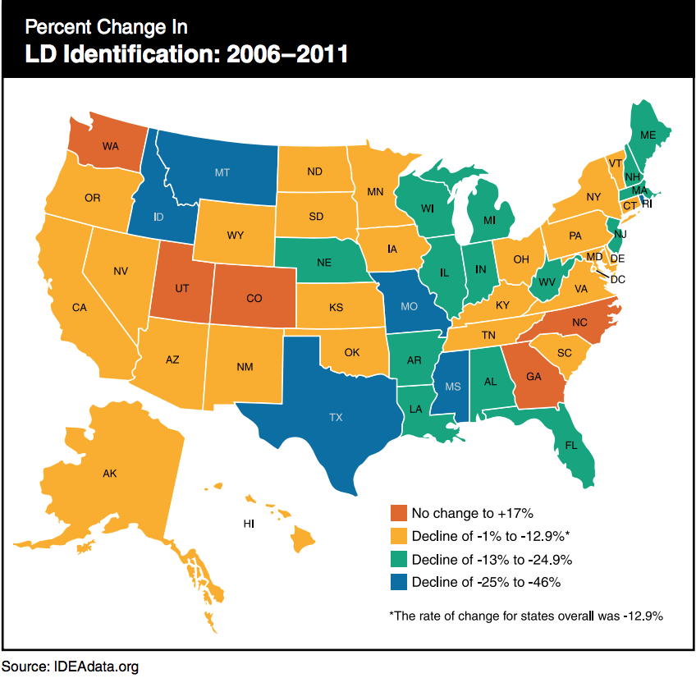
It is up to us!
In many states the percentage of students classified as SLD is declining thanks to the use of best practices such as MTSS, however….
Notes:
National Center for Learning Disabilities 2014

Slide 42

Thank You, Teachers!

